Slide 1

Unhedged Carry Trade:
USD/CHF
Saami Ali & Max Levy

Slide 2
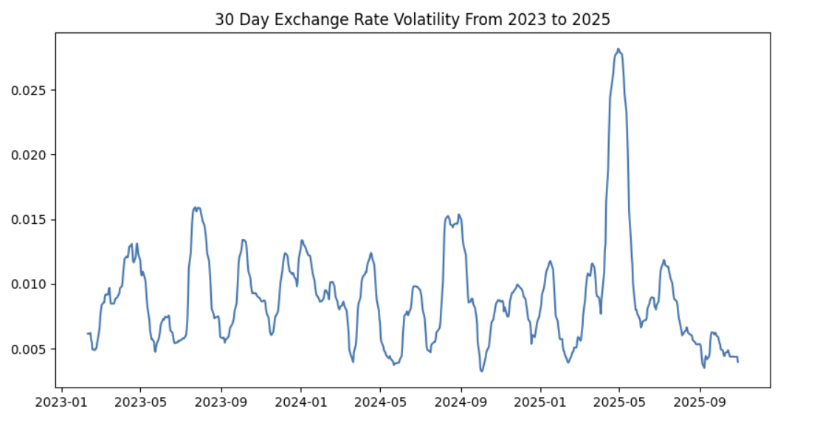
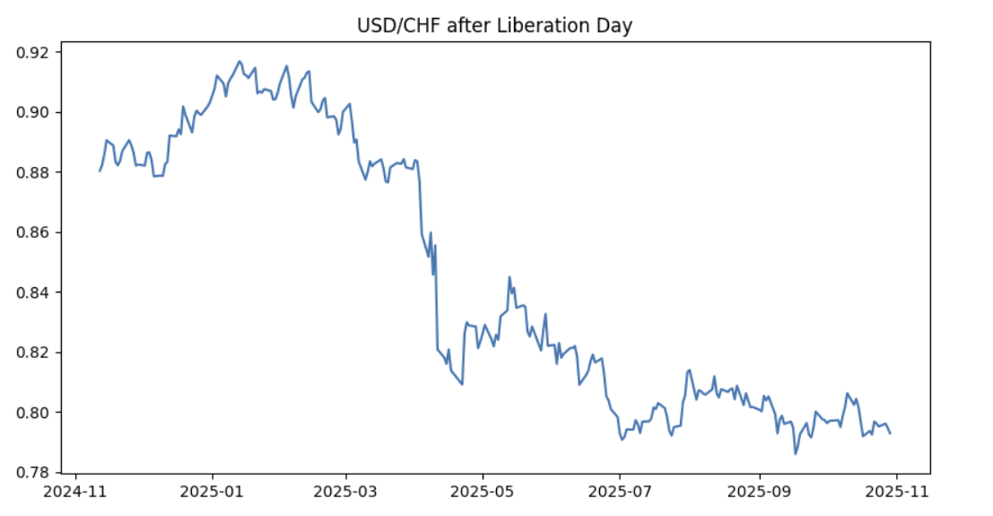
Market Overview: USD/CHF
FX Market Size: Daily FX turnover exceeds $7T; USD/CHF accounts for ~3% of that, confirming liquidity.
Historical Volatility: Prior to Trump’s election in November 2024, the USD/CHF exchange rate had a 30-day volatility of 0.11% from February 2010 to September 2024, showing that USD/CHF volatility is historically lower than the volatility of the US Dollar Index (8.26%), making it an ideal “low-risk carry trade.”

Slide 3
Product Overview: Carry Trade
A carry trade involves borrowing in a currency with a low interest rate and investing in an asset denominated in a higher-yielding currency to capture the rate differential.
If exchange rates never moved, this would be risk-free arbitrage, but since this trade is unhedged, (meaning that we maintain FX exposure) we can still lose money if the currency we invest in depreciates more than the interest spread we capture.
Additionally, unlike other product groups; carry trades aren’t priced in as quickly due to institutional constraints and market segmentation. Additionally, the effective interest spread represents a risk premium in the event of a Black Swan event where funding dries up.
Notes:
A carry trade therefore relies on the funding currency not appreciating, or the investment currency not depreciating, as much as the forward rate implies.

Slide 4
Trade Overview
1Y US Notes yield 3.55%
6M Swiss Bills yield 0.050%
The USD/CHF spot rate is projected to remain stable to slightly bullish
Therefore, we should borrow CHF-denominated 6M bills, swap CHF for USD, and invest the proceeds in 1Y US treasury bonds to profit off of the yield differential.

Slide 5
Macroeconomic Context
United States
Switzerland
Inflation
~2.6%
GDP Growth
~2%
Inflation
~1%
GDP Growth
<1%
Swiss Exports: Weakened exports and tariff frictions with the EU and U.S. have pressured Switzerland’s manufacturing sector, reinforcing dovish policy.
Liberation Day: After Trump announced tariffs, rate volatility struck a peak of greater than 2.5% before settling back down to similar the mean pre-2024 volatility. However, the rate drifted down by 9% from Liberation Day to August at 0.80 and has held firm since after the market absorbed most of the associated shocks.

Slide 6
Macro Drivers: Swiss Foreign Exchange Policy
Sustained Low Swiss Interest Rates
The SNB historically keeps rates low in order to counteract the high demand for CHF that permeates the market
This is due to the fact that an overly strengthened CHF contributes to weakened exports and lower import costs, which in a borderline deflationary economy, is problematic.
Investors demand the Swiss franc due to its status as a safe haven asset during periods of global turmoil.

Slide 7
Macro Drivers: American Rates
American Rate Policy
Resilient USD
Despite global macroeconomic unease, the trend of USD depreciation has been more muted, with the US Dollar Index rising 1.8% following de-escalation of trade tensions with China
Volatility and trade fluctuations will still likely happen, but based on Trump’s track record, a deal or compromise will be reached eventually without any significant short-term equilibrium shifts
Bloomberg consensus projects the USD/CHF exchange rate to remain stable in the near future. Forward rates and forecasts diverge from each other after 2026, beyond the scope of the pitch.
The Fed has signalled a less dovish approach following the FOMC meeting in October with the CME’s Fedwatch lowering its estimates of a cut in December from 90% to 70%
Financial markets have priced in 2-3 cuts during 2026 while the Fed is more conservative with only 1 cut signalled.

Slide 8
Risk Profile
Sovereign Risk
Minimal concern since both countries are OECD members. Long-term U.S. sovereign risk may only impact the far end of the yield curve.
Liquidity Risk
1Y Treasuries are highly liquid, allowing easy exit. However, rapid rate hikes or a broad USD sell-off could force an exit at a discount.
Swiss Rate Hikes
Low probability given slowing growth, weak exports, and sub-target inflation. While not explicitly dovish, the SNB is unlikely to tighten in the near term.
Flight-to-Safety Mechanisms
CHF can strengthen during global shocks, though these events are infrequent. Historical peaks (+7–11% vs USD) represent upper-bound volatility scenarios; recent stability suggests limited near-term risk.
Notes:
Sovereign Risk: While this is a key concern for carry trades in EM bonds, it is much more subdued since both countries are in the OECD. Concerns about long-term US sovereign risk are more likely to affect the tail end of the yield curve
Liquidity Risk: 1Y treasuries are highly liquid, which means that we can exit our position easily. However, we might have to do so at a discount in the event of a rate hike or mass sell-off of USD-denominated assets.
Exchange Rate Risk:
Swiss Rate Hikes: This is a relatively low risk, since the SNB is facing slowing growth, weakened exports due to tariffs, and inflation below the target rate of 0%. While the SNB hasn’t signalled dovish intentions or quantitative easing, analysts believe the door remains open. At the very least, hikes seem to be a tail-end event.
Flight-to-Safety Mechanisms: During times of global instability, the Swiss Franc is viewed as a safety asset, with investors holding the CHF to hedge the market.
In 2008, the CHF appreciated 11% against the USD on the onset of the Global Financial Crisis
In April 2025, the CHF appreciated 7-8% following Trump’s unprecedented shock to the market after announcing tariffs, which gives us an upper bound for exchange rate volatility in the foreseeable future.
It must be noted that despite further volatility, the rate has remained steady which is a positive sign

Slide 9
PnL Profile
Assuming all the bonds are bought at par and the USD/CHF appreciates positively to 0.81:
With leverage of $10 million, we would see a carry of $474,437.50
Borrowing $100 in CHF would effectively yield 4.74% *
* The calculation ignores the cost of rolling Swiss debt and compounding due to different payment profiles.
Assuming more tariff shocks within the year like Liberation Day with the USD/CHF depreciat- ing to 0.78:
With leverage of $10 million, we would see a carry of $86125.00
Borrowing $100 in CHF would effectively yield 0.86%
While the trade has no upfront investment, it is wise to have at least $300,000 on hand to absorb Black Swan losses.
Using this level of cash on hand, we calculate a Sharpe Ratio of 964
Notes:
*Weak assumption, since Swiss rates are negative
** ((0.81/0.80)*(0.0355 * 10000000) - 2 * 0.0005 * 10000000 + (0.81/0.80)*10000000-10000000)
*** Using an estimate one standard deviation below the mean
****((0.78/0.80)*(0.0355*10000000) - 2 * 0.0005*10000000 + (0.78/0.80)*10000000-10000000)
*****(1.097 - 0.0361)/0.0011

Slide 10
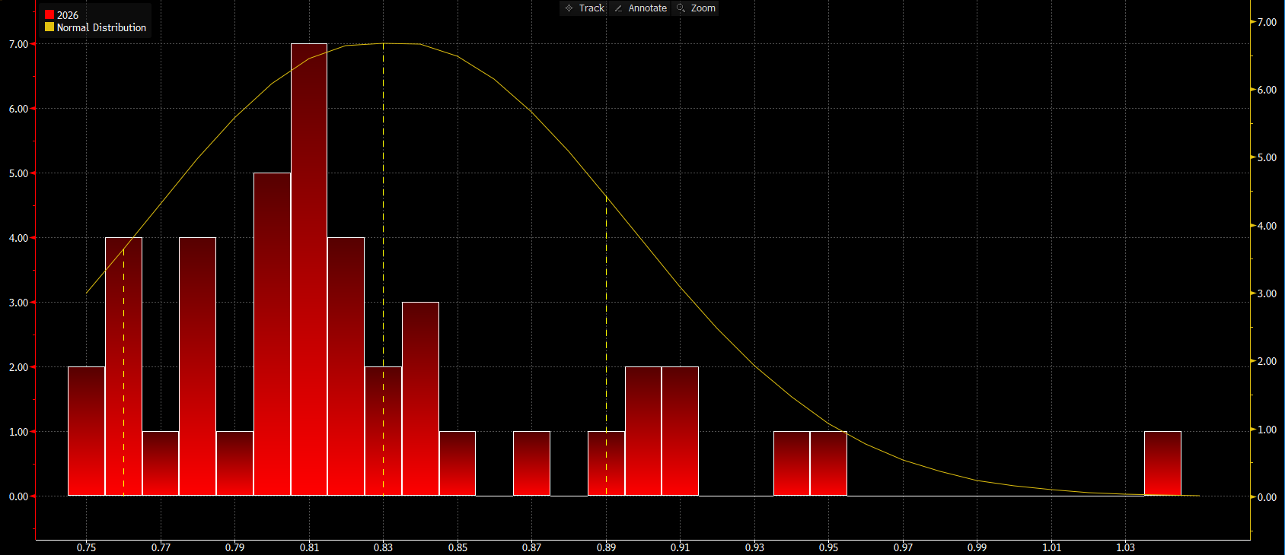
Expected Value Analysis
Expected Value: We used a basic Binomial model and discarded outliers greater than an exchange rate of 0.84, making our estimate more conservative.
Total Predictions: 30
Predictions in Range (0.78-0.83): 19
Predictions in Range (0.75-0.77): 11
EV[Trade] = (19/30)*4.7+(11/30)*0.86
EV[Trade] = $329,200
Distribution of Analysts’ Expectations for the USD/CHF in Late 2026

Slide 11
Execution Timing & Strategy
Borrow CHF denominated Loans
Swap CHF for USD
Roll 6M Swiss Debt
Purchase 1Y US Treasury and Receive Semi-Annual Yield
Exit Profile
If USD/CHF holds and the SNB is steady or dovish, we maintain the position until maturity. If the CHF’s yields remain steady, our interest balance accrues until we reach maturity and repay the balance. If the CHF’s yields become negative, we only have to repay the principal at maturity, by swapping USD for CHF after receiving both the proceeds of the 1Y Treasury and the Swiss notes.
If the USD/CHF fluctuates, maintain the position as long as Swiss rates are steady and there is no defined negative trend in the swap rate.
If the Fed is more dovish than expected (rate cuts into 2026 have been priced in), immediately unwind the trade and sell the 1Y in the secondary market in order to make profit in the secondary market and offset potential losses from an exchange rate shock.

Slide 12
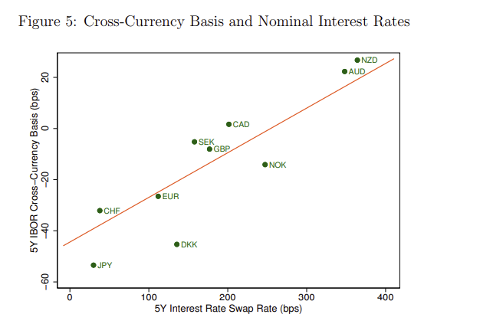


Further Variations of the Trade
Cross Currency Swap
The cross currency basis between the US Dollar and the Swiss Franc, or the difference between the direct treasury interest rate in the cash market and the implied interest rate in the swap market is negative.
This means that a Swiss investor would have to pay more to borrow USD in the swap market than in the cash market. This provides an opportunity of arbitrage for a US investor by borrowing cash and then swapping it in the foreign exchange market for CHF, with a favorable forward rate to swap CHF back to USD when the position reaches maturity.
The basis remains stable due to restrictions on offshore US dollar funding instituted via regulations like BASEL III and continued demand for dollars by investors in countries with lower interest rates available.
This trade is advantageous because it has a near infinite Sharpe Ratio, which indicates an even better risk-return trade-off than our carry trade (which is already low risk).

